Slide 1
Abit sherig

Slide 2
What is abit sherig?
Abit Sherig is a cloud base system design by abit pvt limited keeping in mind to simplify school management in Bhutan that helps schools manage student records, curriculum, attendance, grades, discipline, reporting and lets teachers post grades to mid-term and semester report cards automatically, while an online portal gives students and parents real-time access to information.
To have a view visit our site : www.sherig.abit.bt

Slide 3
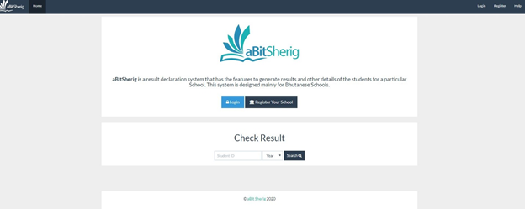
This is the initial view of our site.
In the initial view, students have the option to register themselves with the school of their choice.
Parents and students can view their results using student ID and year.
Login to explore More features for you and your school.

Slide 4
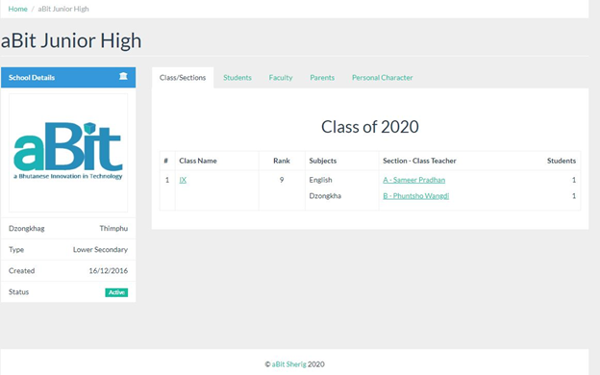
Dashboard view
Tab Available in Dashboard
Class/ Section
Student
Faculty
Parents
Personal Character

Slide 5
Tab Available in Dashboard
Class/ Section
Class / section tab shows Class Name, Class Teacher / Subject Teacher for the class and number of students in the class
Student
Click on Student Tab to View the Details of the student

Slide 6
Tab Available in Dashboard
Faculty
Parents
Click on Faculty Tab to View the Faculty.
Click on the name of the Faculty to view the details.
Once the parents are registered with the school, his or her details will be displayed in this tab.
.

Slide 7
Personal Character
Click on the tab to view on what basis personal character are marked.
On the left have side you will view sidebar with school details

Slide 8
My class
My class is another Tab for the Teachers, where you are assign with the class by your admin(principal)
You can view.
Class Name
Subject you are assign with
Number of student
Below that, you can view the subject for you in different classes.

Slide 9
View Class Details
Click on class Name.
Tabs you will see in this page
New Student
Add SUPW
Assign student
Below, you can view the subject for you in different classes.

Slide 10
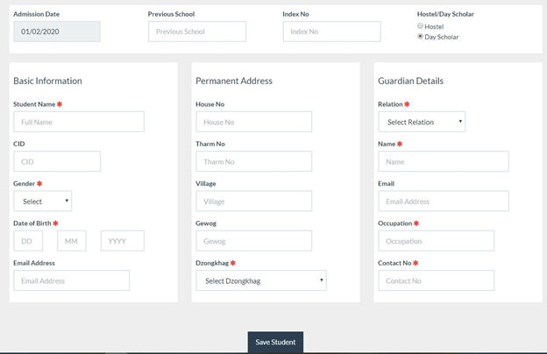
How to add New student?
To add new student, click on New Student
Fill up the form and save the student details.
In the form you will see some are mark with * that indicate its mandatory.

Slide 11
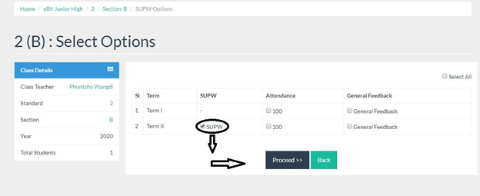
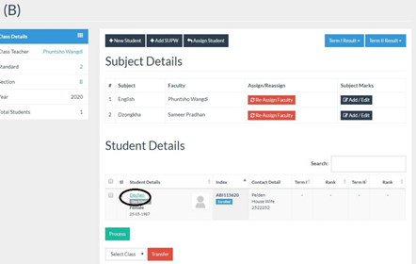
Add SUPW
To add SUPW rating, click on class name.
Click on class name, You will see the student details below.
Tick On SUPW and click proceed to add the SUPW rating
Click on the name of particular student to Add Personal Character
Click on Add PC and update it.
Similarly, to Add TC click on Add TC and update.

Slide 12
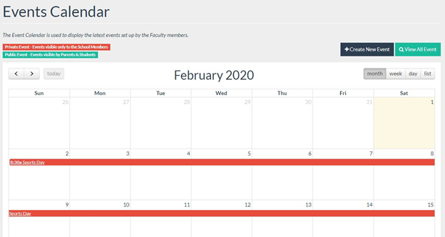
Messages
You can share messages with faculty and the software support team using this messaging system
You will be able to view Message Details at Left hand top corner, which consist of All, Sent, deleted and Compose message in this tab.
Events Calendar
The Event calendar is used to display the latest events set up by the faculty members.
How to create New events
Click on Create New event on right hand top to mark an event.
You will have 2 options to select event types (Public and private).
If you select event type as public all the members and faculty will be able to view the event you created.

Slide 13
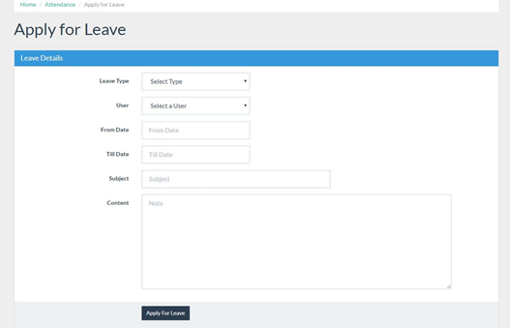
How to Apply for Leave.
Click on the Attendance tab on the Menu.
Click on the Apply for Leave button which will appear on the right hand top corner.
You will have the option to select leave type, User, Date, Subject and Content.
Using the User menu option, you can apply for leave for yourself and for your student.
Fill up all the requirements and click on apply for Leave.
Once the form is Submitted, the application will appear on the admin(principal) system where he or she can approve or reject the application.

Slide 14
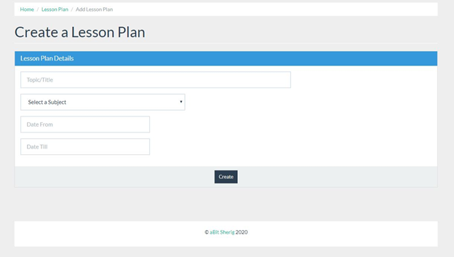
How to prepare a Lesson Plan?
A faculty with assigned subject can create a lesson plan for that particular subject. The Plan is Approved/Rejected by the Principal.
Click on the Lesson Plan tab on the navbar
Click on the Create New button which will appear on the right hand top corner
Fill up all the requirement and click on create and submit your application.
Once the form is Submitted, the application will appear on the Admin(principal) system where he or she can approve or reject the application.
View of the form Once Admin Approve your proposal.
Prepare your lesson plan here and update to keep a record.

Slide 15
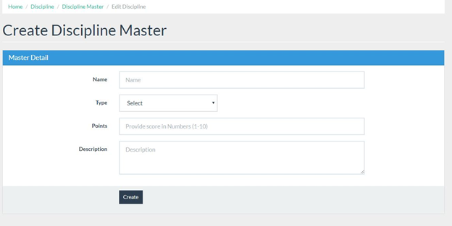
Disciplinary
Students with disciplinary actions can be marked. There are Two types of actions, Good/Bad.
Click on the Discipline tab on the navbar.
Click on the View Master button which will appear on the right hand top corner
Click on the Add New button if you want to add a Disciplinary Record on a student which will be seen on his profile.
Points 1-10 is the scale depending on the behavior of the student.

Slide 16
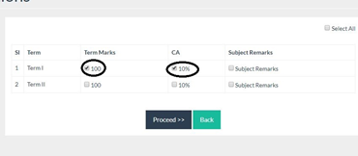
How to prepare Result
Enter into My class.
Click on Class name.
Below the subject marks, click on Add or Edit to Enter the Marks of Student.
You will have option to select Term I or Term II.
Click on which Mark you want to add, as shown below and click on proceed.

Slide 17
Conclusion
The only way any school can operate to its strength it to make the management job easier, make information more accessible and enable everyone to be the part of the school management systems.
Students, administrators and anyone connected with the school administration get 24/7 access to information, from anywhere and anytime.

Slide 18
Student
Attendance, discipline, grades, and achievements! Almost all the information regarding the students can be accessed easily using school management software.
Parent
Helps parents to actively participate in their children’s educational activities
Provides up-to-date information regarding PTM, grades, assignments etc.
Teacher
School management software not only helps in availing information regarding students but also provides information regarding teacher activities inside the school.

Slide 19
Thank you

